Slide 1

Module 5 – Advanced Analytics on Big Data( Spark ML Lib)

Slide 2

Advanced Analytics on Big Data
Introduction to Spark ML
Feature Extraction
Term Frequency, Inverse Document Frequency
Basic Statistics
Chi-squared test,min,max,variance, mean,Pearson Correlation
Linear regression, logistic regression
Support Vector Machine
Naives Bayes Classifier
Decision Trees
K-means Clustering
Principal component analysis, Singular value decomposition
Recommendations using ALS

Slide 3
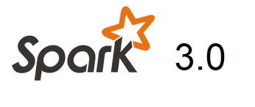
Advanced Analytics on Big Data
Introduction to Spark ML
The previous API was called “MLLib” and used RDD’s and some specialized data structures.
MLLib is deprecated in Spark 3
The newer “ML” library just uses dataframes for everything

Slide 4
Advanced Analytics on Big Data
Introduction to Spark ML
Found it Useful
“ Advanced Analytics with Spark” O Reilly

Slide 5
Advanced Analytics on Big Data
Introduction to Spark ML-ML Pipeline

Slide 6
Advanced Analytics on Big Data
Introduction to Spark ML
What is a Dataframe?
a distributed collection of data organized into named columns
Like a table in a relational database
Features
Scales from KBs to PBs
Supports wide array of data formats and storage systems (Hive, existing RDDs, etc)
State-of-the-art optimization and code generation via Spark SQL Catalyst optimizer
APIs in Python, Java

Slide 7

Advanced Analytics on Big Data
Introduction to Spark ML

Slide 8
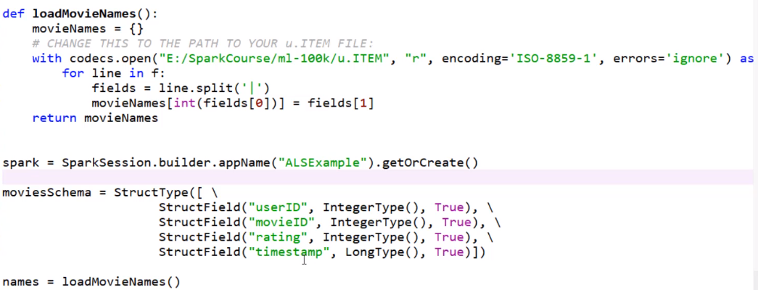
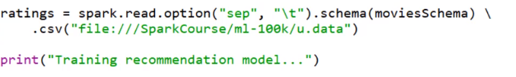
Advanced Analytics on Big Data
Introduction to Spark ML

Slide 9
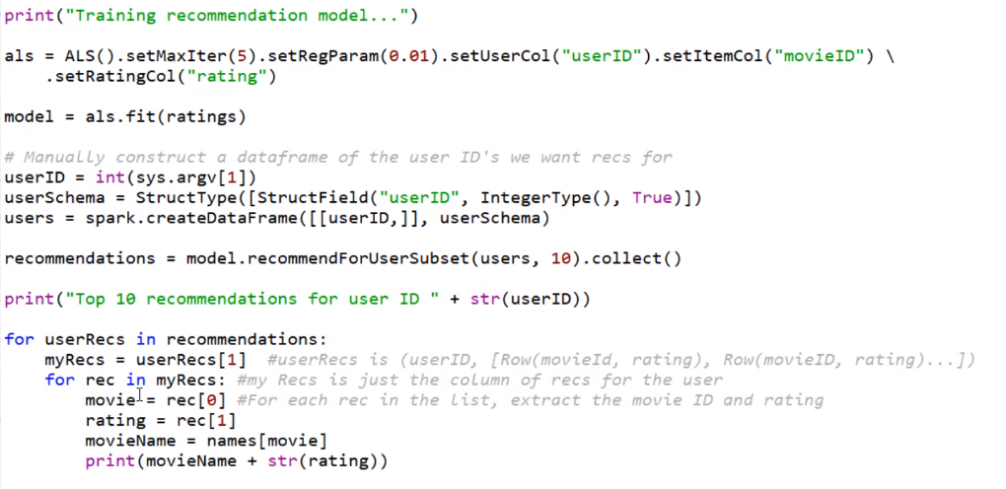
Advanced Analytics on Big Data
Introduction to Spark ML

Slide 10
THANK YOU

